Slide 1
Block chain Technology

Slide 2
Course Code: 22MCA343
Teaching Hours/Week (L: T: P: S) 3:0:0:0
Credits 03
Total Teaching Hours 40
CIE + SEE Marks 50+50

Slide 3
UNIT-I
Introduction
08 Hours
Introduction to Blockchain- How Blockchain works- Blockchain vs Bitcoin- Practical applications- public and private key basics- pros and cons of Blockchain- Myths about Bitcoin.
UNIT-II
Blockchain Architecture
08 Hours
Blockchain Architecture- versions- variants- use cases- Life use cases of blockchain- Blockchain vs shared Database- Introduction to crypto currencies- Types- Applications.

Slide 4
UNIT-III
Double Spending
08 Hours
Concept of Double Spending- Hashing- Mining- Proof of work. Introduction to Merkel tree- Privacy- payment verification- Resolving Conflicts- Creation of Blocks.
UNIT – IV
Introduction to Bitcoin
08 Hours
Introduction to Bitcoin- key concepts of Bitcoin- Merits and De Merits Fork and Segwits- Sending and Receiving bitcoins- choosing bitcoin wallet- Converting Bitcoins to Fiat Currency.

Slide 5
UNIT-V
Introduction to Ethereum
08 Hours
Introduction to Ethereum- Advantages and Disadvantages- Ethereum vs Bitcoin- Introduction to Smart contracts- usage- application- working principle- Law and Regulations. Case Study

Slide 6
TEXTBOOKS:
1. Arshdeep Bikramaditya Signal, Gautam Dhameja, “Beginning Blockchain: A Beginner's Guide to Building Blockchain Solutions”, APress.
2. Bahga, Vijay Madisetti, “Blockchain Applications: A Hands-On Approach”. 31 January 2017
3. Melanie Swan, “Blockchain”, Oreilly

Slide 7
Block Chain Technology
Unit 1

Slide 8

Why I Should Study Blockchain
It is a Disruptive Technology

Slide 9

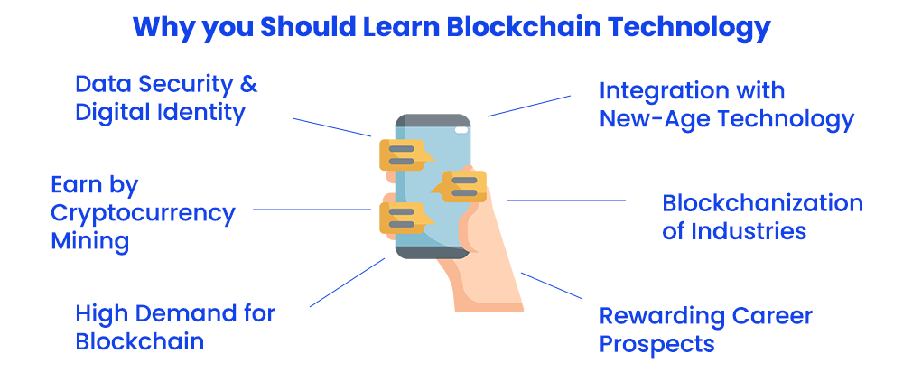

Slide 10
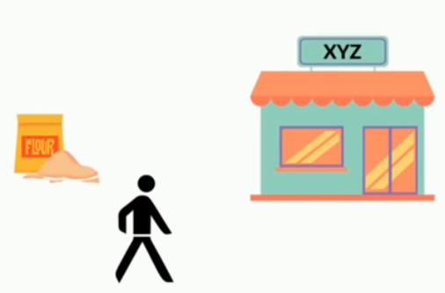
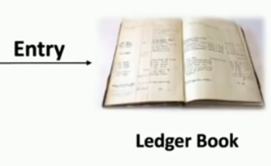

What is Blockchain

Slide 11
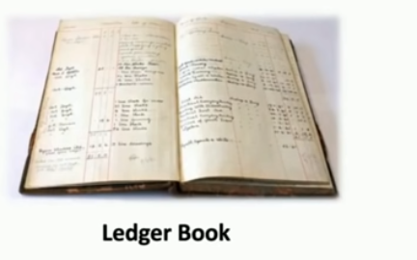
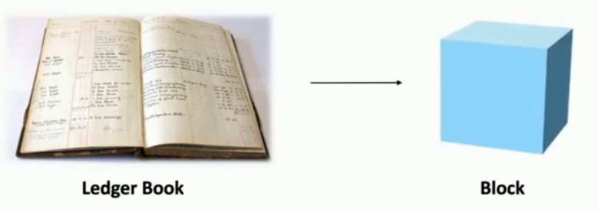
What is Blockchain

Slide 12
What Is Blockchain?
Blockchain is like a digital notebook that is
→ Shared by many people
→ Can't be changed once something is written
→ Very secure and transparent
It records transactions or data in blocks, and each block is linked to the previous one, forming a chain hence the name block-chain.

Slide 13
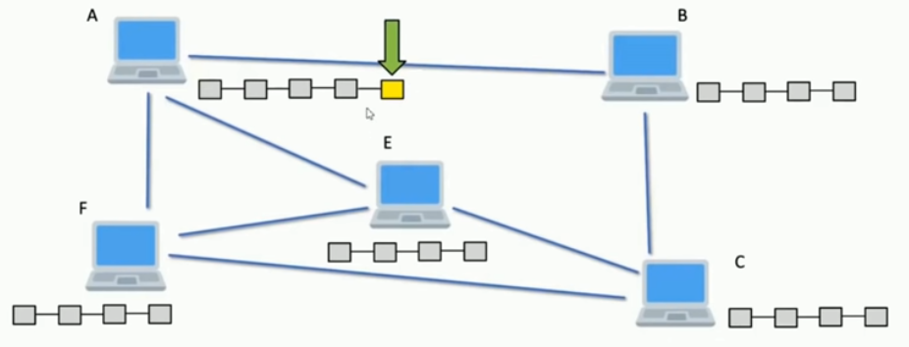
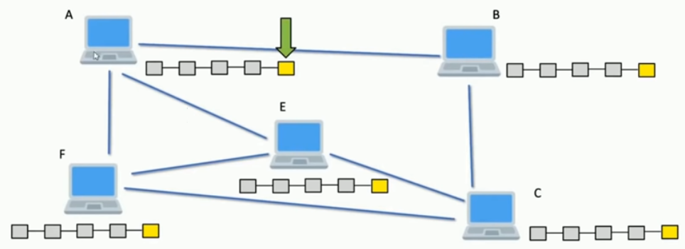
What is Blockchain

Slide 14
Introduction to Block Chain
→ The blockchain is a distributed database of records of all transactions or digital events that have been executed and shared among participating parties.
→ Each transaction is verified by the majority of participants of the system.
→ It contains every single record of each transaction.

Slide 15
→ Bitcoin is the most popular cryptocurrency an example of the blockchain.
Blockchain is a system of records to transact value (not just money!) in a peer-to-peer fashion.
→ Blockchain is a peer-to-peer system of transacting values with no trusted third parties in between.
→ This ledger database is an append-only database and cannot be changed or altered. It means that every entry is a permanent entry. Any new entry on it gets reflected on all copies of the databases hosted on different nodes.

Slide 16
→ This ledger database is an append-only database and cannot be changed or altered. It means that every entry is a permanent entry. Any new entry on it gets reflected on all copies of the databases hosted on different nodes.
→ There is no need for a trusted intermediary such as banks, brokers, or other escrow services to serve as a trusted third party.
For example, if Alice pays to Bob $10.

Slide 17
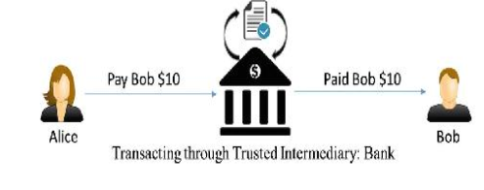
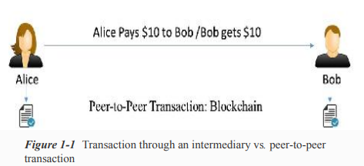

Slide 18
Example 2:
A typical stock transaction happens in seconds, but its settlement takes weeks.

Slide 19
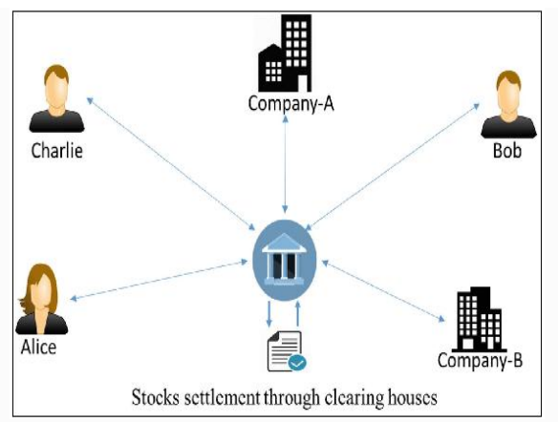

Slide 20
If someone wants to buy some stocks from a company or a person, they can just directly buy it from them with instant settlement, with no need for brokers, clearing houses, or other financial institutions in between.

Slide 21
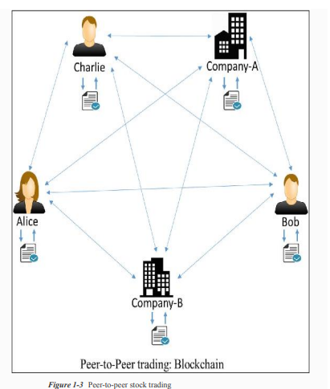
A decentralized and peer-to peer solution to such a situation can be represented as:

Slide 22
LET’S FIRST TALK ABOUT BANKING

Slide 23
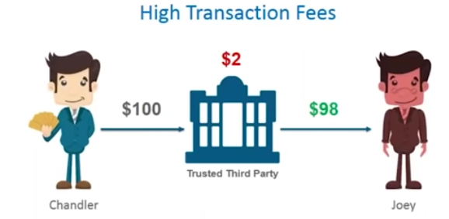
LET’S FIRST TALK ABOUT BANKING-ISSUES

Slide 24
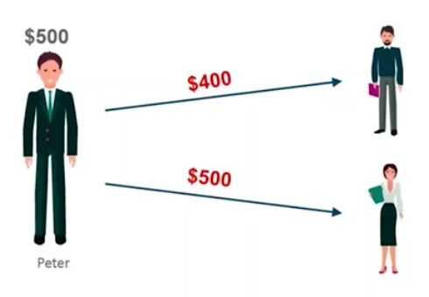

LET’S FIRST TALK ABOUT BANKING-ISSUES
Double Spending - Simultaneously

Slide 25
HOW DO YOU TRANSACT?
Your write a check or do internet transaction to pay a payee
Bank checks if you have balance > transaction amount
If yes, it debits your account by balance = balance ‐ transaction_amount
credit’s payee’s account by payee.balance = payee.balance + transaction_amount
If no, the transaction is invalid and rejected.
You can check your transaction list online, or check the monthly statement
Who maintains the ledger?
Bank Does
What if Bank allows an invalid transaction go through
Invalid = you did not authenticate the transaction
Invalid = your balance was not sufficient but transaction was made

Slide 26
Bank Frauds
You find a check was used to pay someone but you never wrote the check
Someone forged your check and/or signature
You did sign a check for x amount, but the amount field was modified
How do you prove to the bank that an extra 0 was not there in your signing time?
The monthly statement says that you did a transaction but you did not recall or the amount of a transaction is different from what you had done
Someone got your password, and possibly redirected OTP to another SIM (SIM Fraud)
Bank employees themselves might have done something
How do you argue to the bank? (Non-repudiation)
How do you argue that the amount was modified? (Integrity)
Finally, do you tally your transactions when you receive your monthly statement?
Most people do not

Slide 30
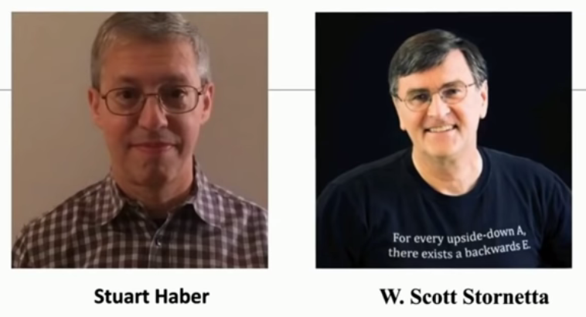
Again, What is a Blockchain? –who invented?
Proposed in their research paper published in 1991, entitled, “How to digitally time stamp a document”

Slide 31
How Does the Blockchain Work?
A blockchain is a distributed database that stores information electronically in a digital format and is shared among the nodes of a computer network. A typical difference between a blockchain and a database is how data is structured. A blockchain is a shared, immutable ledger as the name suggests structures data into chunks or blocks, and a database structures data into tables. A blockchain is a chain of blocks. Once a block is filled with data and it is chained to the previous blocks. Different types of information can be stored on the blockchain network but the most important is transactions.
The transaction process in a blockchain can be summarized as follows:
1. Facilitating a transaction: A new transaction enters the blockchain network. All the information that needs to be transmitted is doubly encrypted using public and private keys.
2. Verification of transaction: The transaction is then transmitted to the network of peer-to-peer computers distributed across the world. All the nodes on the network will check for the validity of the transaction like if a sufficient balance is available for carrying out the transaction.
3. Formation of a new block: In a typical blockchain network there are many nodes and many transactions get verified at a time. Once the transaction is verified and declared a legitimate transaction, it will be added to the mem pool. All the verified transactions at a particular node form a mem pool and such multiple mem pools form a block.
4. Consensus Algorithm: The nodes that form a block will try to add the block to the blockchain network to make it permanent. But if every node is allowed to add blocks in this manner then it will disrupt the working of the blockchain network. To solve this problem, the nodes use a consensus mechanism to ensure that every new block that is added to the Blockchain is the one and only version of the truth that is agreed upon by all the nodes in the Blockchain, and only a valid block is securely attached to the blockchain.

Slide 32
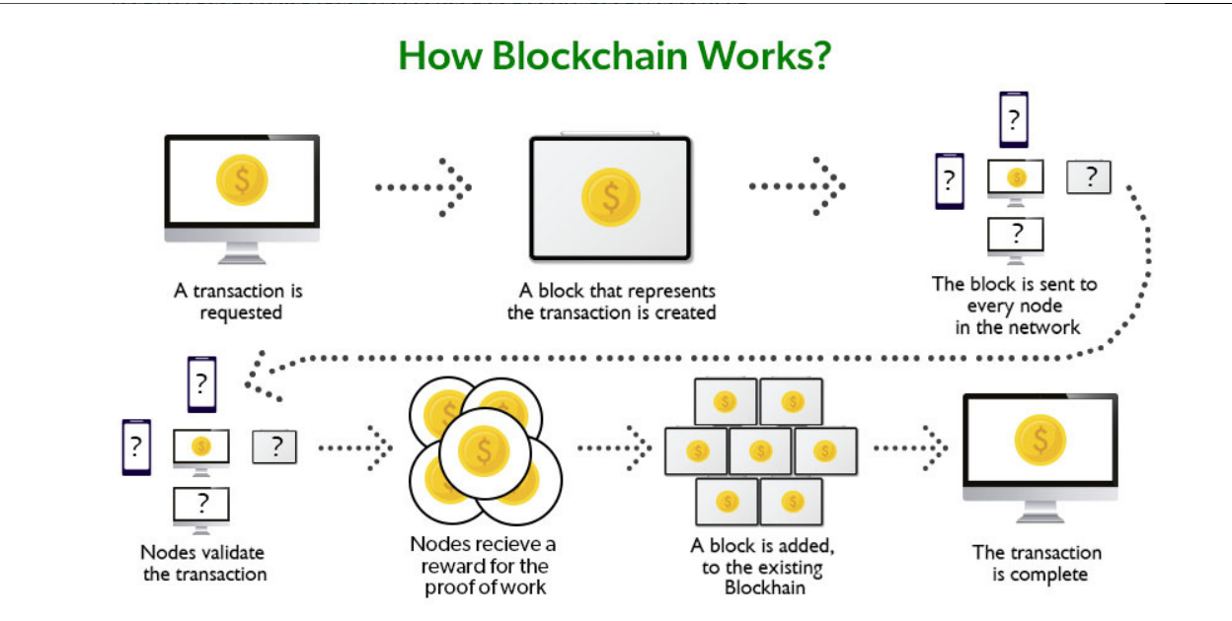
The node that is selected to add a block to the blockchain will get a reward and hence we call them “miners”. The consensus algorithm creates a hash code for that block which is required to add the block to the blockchain
5. Addition of the new block to the blockchain: After the newly created block has got its hash value and is authenticated, now it is ready to be added to the blockchain. In every block, there is a hash value of the previous block and that is how the blocks are cryptographically linked to each other to form a blockchain. A new block gets added to the open end of the blockchain.
6. Transaction complete: As soon as the block is added to the blockchain the transaction is completed and the details of this transaction are permanently stored in the blockchain. Anyone can fetch the details of the transaction and confirm the transaction.

Slide 33
Let’s understand this working of blockchain with the help of an example:
Let’s say Jack and Phil are two nodes on the bitcoin blockchain network who wants to carry out a transaction between them.
Step 1: Facilitating the transaction: Jack wants to send 20 BTC to Phil via the Blockchain network.
Step 2: Verification of transaction: The message for verification will be sent to all the nodes on the network. All the nodes will check the important parameters related to the transaction like Does Jack has sufficient balance i.e. at least 20BTC to perform the transaction. Is Jack a registered node? Is Phil a registered node? After checking the parameters the transaction is verified.
Step 3: Formation of a new block: A number of verified transactions stack up in mem pools and get stored in a block. This verified transaction will also get stored in a block.
Step 4: Consensus algorithm: Since here we are talking about bitcoins so the Proof-of-Work consensus algorithm will be used for block verification. In proof-of-work, the system assigns the target hash value to a node, and according to this, it must come up with a hash for the new block. The node has to calculate the hash value for the new block that is less than the target value. If two or more miners mine the same block at the same time, the block with more difficulty is selected. The others are known as stale blocks. Mining usually rewards miners with blockchain currency. In this case, the blockchain currency is bitcoin.
Step 5: Addition of the new block in the blockchain: After the newly created block has got the hash value and authentication through proof-of-work only then it will be added to the network and the transaction will mark as complete. Phil will receive 20 BTC from jack. The new block will be linked to the open end of the blockchain.

Slide 34
Step 6: Transaction complete: As soon as the block is added to the blockchain, the transaction will take place and 20 BTCs will get transferred from Jack’s wallet to Phil’s wallet. The details of the transaction are permanently secured on the blockchain.
Anyone on the network can fetch the information and confirm the transaction. This will help to keep track of all the transactions and to verify whether any user is trying to double spend. For example, if Jack tries to carry out a transaction in the future, the rest of the nodes can check Jack’s past transaction records to check whether Jack has enough balance to carry out the current transaction. If there is enough balance then the transaction will be approved.

Slide 35
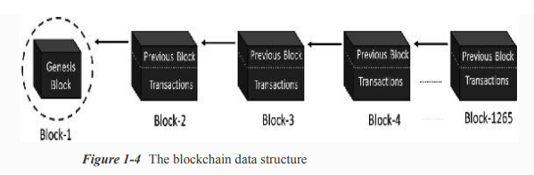
How Block Chain Works?

Slide 36
→Every node on the blockchain network has an identical copy of the blockchain, where every block is a collection of transactions
→ There are two major parts in every block. The “header” part links back to the previous block in the chain.
→ Every block header contains the hash of the previous block so that no one can alter any transaction in the previous block.
The other part of a block is the “body content” that has a validated list of transactions, their amounts, the addresses of the parties involved, and some more details

Slide 37
Example 1:
Assume that there are three candidates—Alice, Bob, and Charlie—who are doing some monetary transactions among each other on a blockchain network.

Slide 38
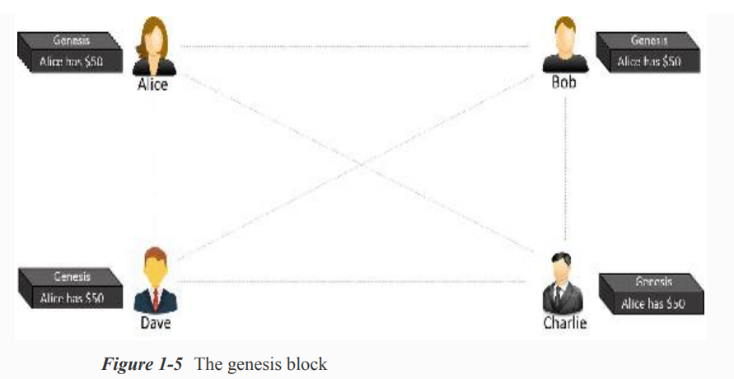
Step-1:
Let us assume that Alice had $50 with her, which is the genesis of all transactions and every node is aware of it, as shown in Figure

Slide 39
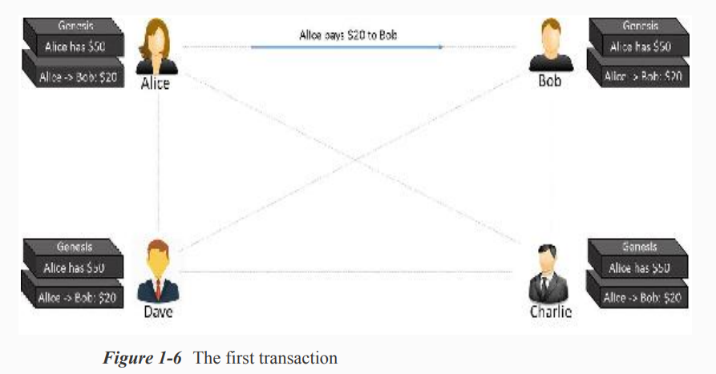
Step-2: Alice makes a transaction by paying $20 to Bob. Observe how the blockchain gets updated at each node, as shown in Figure

Slide 40
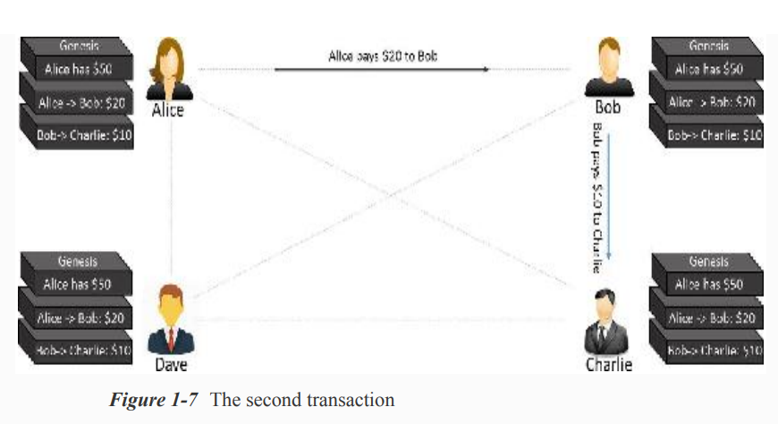
Step-3: Bob makes another transaction by paying $10 to Charlie and the blockchain gets updated as shown in Figure

Slide 41
The transaction data in the blocks is immutable.
All transactions are fully irreversible.
Any change would result in a new transaction, which would get validated by all contributing nodes

Slide 42
Centralized vs Decentralized system
A centralized distributed system is one in which there is a master node responsible for breaking down the tasks or data and distribute the load across nodes.
On the other hand, a decentralized distributed system is one where there is no “master” node as such and yet the computation may be distributed.
Blockchain is one such example

Slide 43
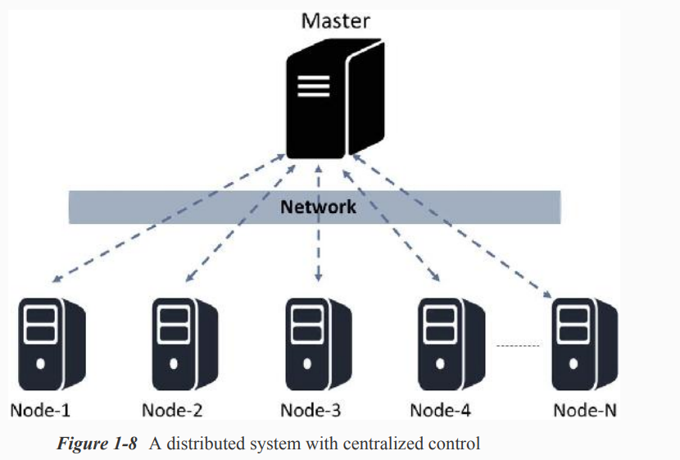

Slide 44
Centralized systems
→ A centralized system has a centralized control with all administrative authority. Such systems are easy to design, maintain, impose trust, and govern, but suffer from many inherent limitations, as follows:
They have a central point of failure, so are less stable.
They are more vulnerable to attack and hence less secured.
Centralization of power can lead to unethical operations.
Scalability is difficult most of the time.

Slide 45
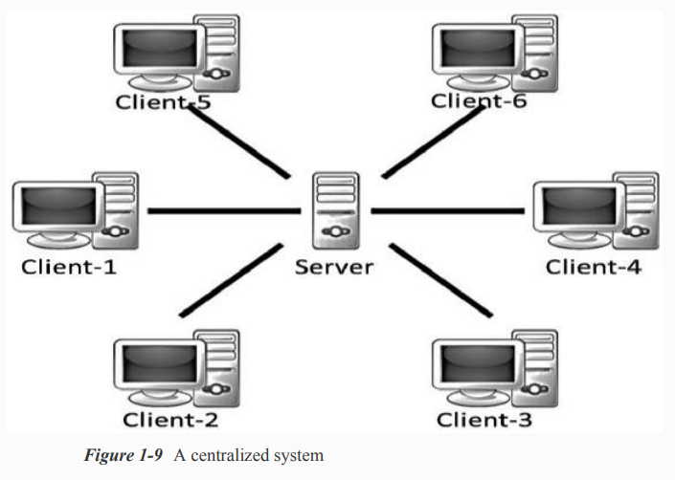

Slide 46
Decentralized System
→ A decentralized system does not have a centralized control and every node has equal authority. Such systems are difficult to design, maintain, govern, or impose trust. However, they do not suffer from the limitations of conventional centralized systems. Decentralized systems offer the following advantages:
They do not have a central point of failure, so more stable and fault tolerant
Attack resistant, as no central point to easily attack and hence more secured
Symmetric system with equal authority to all, so less scope of unethical operations

Slide 47
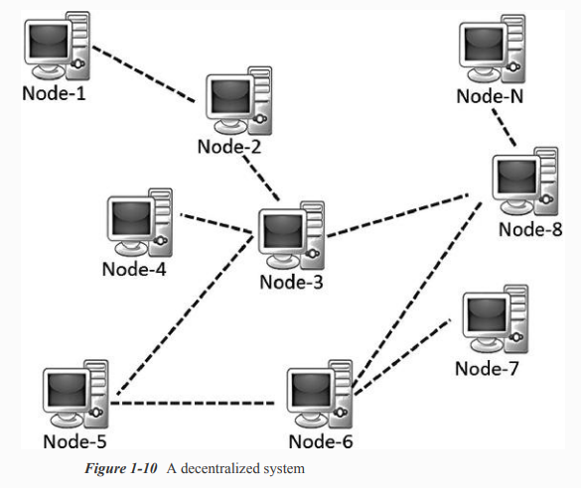

Slide 48
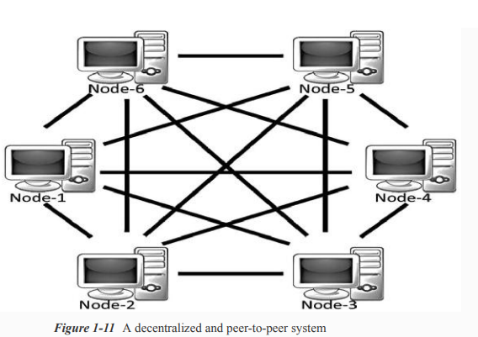

Slide 49
Blockchain Vs Bitcoin
The basis for comparison between Bitcoin vs Blockchain | Bitcoin | Blockchain
What is it? | A crypto-currency | A digital ledger
Main Aim | To simplify and increase the speed of transactions without much of government restrictions. | To provide a low cost, safe, and secure environment for peer-to-peer transactions.
Trade | Bitcoin is limited to trading as a currency. | Blockchain can easily transfer anything from currencies to property rights of stocks.
Scope | The scope of bitcoin is limited. | The blockchain is more open to changes and hence has the backing of many top companies.

Slide 50
Blockchain Vs Bitcoin
Strategy | Bitcoin focuses on lowering the cost of influencers and reduces the time of transactions but is less flexible. | Blockchain can be adapted to any change and hence it can cater to different industries.
Status | Bitcoin likes to be anonymous and hence even though we can see the transactions in the ledger, they are numbers that are not in any particular sequence. | As blockchain works with various businesses, it should have compliance with KYC and other norms. Hence blockchain is very transparent.

Slide 51
Benefits of Blockchain Technology
Time-saving: No central Authority verification needed for settlements making the process faster and cheaper.
Cost-saving: A Blockchain network reduces expenses in several ways. No need for third-party verification. Participants can share assets directly. Intermediaries are reduced. Transaction efforts are minimized as every participant has a copy of shared ledger.
Tighter security: No one can temper with Blockchain Data as it shared among millions of Participant. The system is safe against cybercrimes and Fraud.

Slide 52
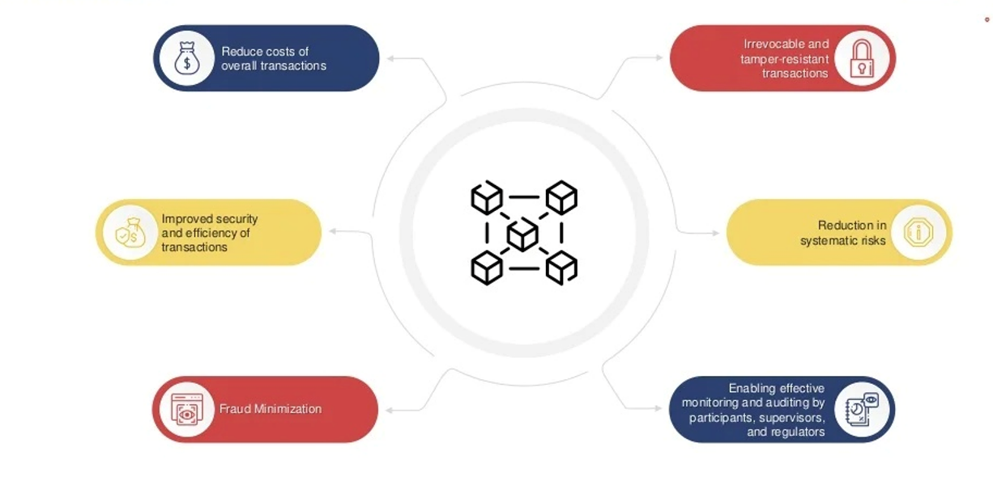
How Blockchain Transforming Business

Slide 53

Myths About Bitcoin
1.Bitcoin Is Dead
The most common myth that people repeat about Bitcoin is that it is dead and no longer used by anyone in the world. There is a website, Bitcoin Obituaries, which keeps track of the declarations of Bitcoin’s death going all the way back to 2010. At that time, bitcoin was trading at $0.23.
In reality, Bitcoin is currently at its most successful point in history -- at least when measured by the number of transactions that are happening on the network every day. The real problem right now is scalability (increasing block size to handle more transactions), which Blockchain Capital Managing Partner Brock Pierce recently pointed out is a sign of its success.

Slide 54

2.Bitcoin Is Anonymous
Although Bitcoin is often referred to as the “anonymous currency of the dark web,” it is more correct to say that Bitcoin addresses are pseudonymous. This means that there is an identifiable address (or many addresses) for each user on the network, but no one necessarily knows who is behind each address.
With Bitcoin, it’s important to remember that every transaction is recorded on a completely public ledger that anyone can view on a block explorer. A few blockchain analytics companies have popped up over the past few years, and they’re able to deanonymize large portions of the network.

Slide 55
3. Bitcoin Is Completely Transparent
It’s also a myth that Bitcoin is completely transparent. As mentioned in the above section, the true identities of the individuals or organizations behind specific Bitcoin addresses are not always known. There are also various privacy-enhancing services, such as JoinMarket, which allow users to enhance their privacy on the blockchain. There are also other enhancements, such as Confidential Transactions and Zerocash, that could come to Bitcoin in due time.
Rather than being completely anonymous or completely transparent, Bitcoin is better identified as somewhere between these two extremes.

Slide 56
4. Bitcoin Is Used by Terrorists
Whenever Bitcoin is brought up in a movie or television show, it’s almost always being used by some kind of serious criminal or terrorist; however there is no evidence of terrorists using Bitcoin on any noteworthy scale. In fact, a Europol investigation from earlier in the year found, “Despite third-party reporting suggesting the use of anonymous currencies like Bitcoin by terrorists to finance their activities, this has not been confirmed by law enforcement.”
Although Bitcoin is sometimes used for illegal transactions on the Internet, the reality is that the privacy issues related to the public blockchain make it a poor choice for terrorists. In the world of untraceable payments, cash is still king.The Winklevoss Twins, who founded a Bitcoin exchange called Gemini, have gone as far as to say Bitcoin is a haven for really stupid criminals.

Slide 57
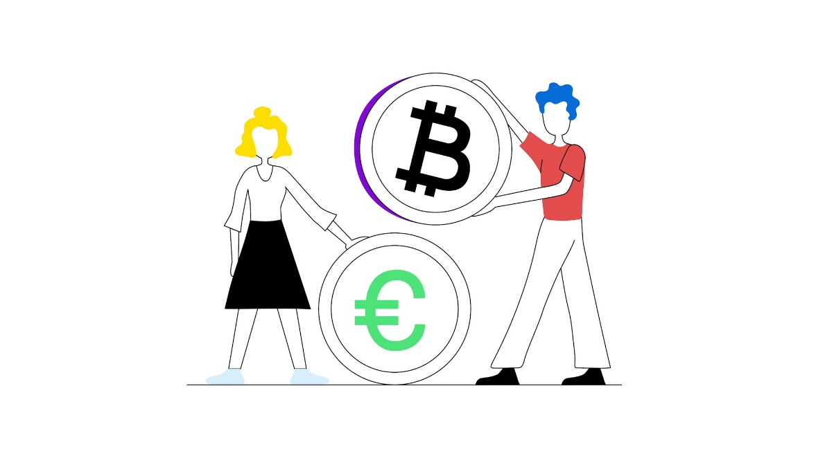
5. Bitcoin Is Not Backed By Anything, So It Has No Value
Many gold bugs and those who do not understand the value of a decentralized, censorship-resistant digital payment network believe bitcoins are essentially worthless because they aren’t backed by anything. There are varying opinions on this point. Some believe bitcoin’s scarcity is the main attribute that gives it value, while others claim bitcoins are useful because they are required to use the world’s most prominent and secure decentralized ledger.
Currency Wars author and gold bull Jim Rickards recently took issue with the argument that bitcoins are backed by nothing, pointing out that like all currency in the history of money, bitcoins are backed by confidence. (Also known as consensus.) Gold is valuable because people agree that it is.

Slide 58
6. Bitcoin’s Price Volatility Makes It Useless
While Bitcoin has had quite a volatile history, the trend has definitely been toward stability since the first blocks were mined in early 2009. Having said that, not many people are attempting to use bitcoin as a unit of account right now. Instead, the digital currency, commodity or however you want to define it is mainly viewed as a store of value by those who hold it.
There are also various mechanisms for using the Bitcoin network for payments while avoiding the volatility associated with the token of value. Some Bitcoin companies, such as Circle and Coinbase, allow users to store funds in U.S. dollars or other fiat currencies before making Bitcoin transactions on the user’s behalf.

Slide 59
7. Bitcoin Is Only Used for Illegitimate Purposes
One of the fundamental values of Bitcoin is its resistance to censorship. As Elon Musk put it in 2014
“I think it’s primarily going to be a means of doing illegal transactions. But that’s not necessarily entirely bad. You know, some things maybe shouldn’t be illegal.”
What is or isn’t a legitimate or legal transaction can change when moving between various jurisdictions, but Bitcoin is also used for completely legal purposes. Some people use Bitcoin to save 10-20 percent on purchases at Amazon, Starbucks and Target via Foldapp and Purse.io. Others see it as a valuable tool for cheaper international money transfers and remittances. Abra, Align Commerce and Freemit are three startups using Bitcoin to lower the costs of money transfers around the world.
8. Bitcoin Mining Wastes Electricity
A recent report found that Bitcoin’s network hashrate could consume as much power as Denmark by 2020. Other reporters dispute this characterization, pointing out that Bitcoin uses the same electricity as the yearly consumption of 674.5 average American homes, two Amtrak locomotives or a California hydroelectric plant. Do these things waste electricity? It depends on your point of view. The reality is that the use of computing power serves a purpose in Bitcoin, which is securing all of the transactions on the network. If you don’t think Bitcoin is valuable, maybe that’s a waste. If you don’t think fiat currencies are valuable, maybe keeping the lights on at the Federal Reserve is a waste.
Electricity-intensive Bitcoin mining is essentially a way to prove that someone has expended resources in hopes of getting a block reward and transaction fees in return for their efforts. Proof-of-work, as it’s called, acts as a prevention mechanism against Sybil attacks (forged identities) on the Bitcoin network. Waste? You decide.

Slide 60
Applications and Uses of Blockchain
Cryptocurrencies: A cryptocurrency is a digital currency, basically designed to be used as a medium of exchange wherein each coin ownership record is stored in a decentralized ledger. Cryptocurrencies use ‘decentralized control’, which suggests that they are not controlled by one person or government. When Bitcoin launched in 2008, it allowed people to directly transact with each other without having to trust third parties like banks. Since then 4000 different cryptocurrencies have been created. Some examples are Bitcoin, Ethereum, Dogecoin, Fantom, etc. The blockchain is the technology behind cryptos where all the exchange or transaction information is stored which cannot be hacked or changed and a copy of the ledger is distributed among all the participants of the network. It records every single transaction. Each and every person can buy/sell or deal in cryptos and be a part of the network. Nowadays, several financial applications provide a user with the luxury of doing so.
Cars: Let us see how can blockchain be used in cars. Ever heard of odometer fraud? By tampering with the odometer, someone can make a car appear to be newer and less worn out, resulting in customers paying more than what the car is actually worth. The government tries to encounter by collecting the mileage of cars when they get a safety inspection, but that’s not enough. So, instead, we could replace regular odometers with smart ones that are connected to the internet and frequently write the car’s mileage to the blockchain. This would create a secure and digital certificate for every car. And because we use a blockchain, nobody can tamper with the data/information, and everyone can look up a vehicle’s history to ensure it’s correct. In fact, this has already been developed used by Bosch’s IoT lab and they are currently testing it on a fleet of 100 cars in Germany and Switzerland.

Slide 61
Legal Documents: So, blockchains are great at keeping a good track of data over time. So, besides odometers, you can keep track of things like intellectual property or patents or it can even function as a notary. A notary is someone (for example the Central Government) who can confirm and verify signatures on legal documents. But we can just as well use blockchain for it. The online website stampd.io as an example, allows you to feature the documents to the Bitcoin or Ethereum Blockchain. Once, a document has been added you can always prove that you simply created a document at a particular point of time very similar to a notary, although right now blockchains are not on the same level as notaries in a legal perspective.
Digital Voting: Another interesting application is digital voting. Right now voting happens either on paper or EVM (electronic voting machines) which are special computers running proprietary software. Voting on paper costs a lot of money and wastage and electronic voting has security issues. In recent years we have seen countries move away from digital voting and adopting paper again because they fear that electronic votes can be tampered with and influenced by hackers. In our country as well, we have seen politicians fight over “EVM hack” things. But, in place of paper ballots or EVMs, we could use blockchains to cast and store votes. Such a system would be very transparent and everyone could verify the voting count for themselves and it would make tampering with it very difficult. The Swiss company Agora is already working on such a system and it is going to be completely open-source. But there are many challenges. First, you have to be able to verify voters without compromising their privacy. Secondly, if you allow people to vote with their own computers or phones, you have to take care of the situation that those devices might be infected with malware designed to tamper with the voting process. And a final example: a system like this also has to be able to withstand denial-of-service attacks that could render the whole thing unusable. Definitely, a very tough nut to crack but if it becomes reality it could make for a more transparent and practical voting system.

Slide 62
Food and Medical Industry: They could use blockchain technology to track their food products from the moment they are harvested or made, to when they end up in the hands of the customers. See, every year almost half a million people die because of food-borne diseases and that’s partly because it takes too long to isolate the food that is causing harm. Blockchains could help us to create a digital certificate for each package of food, proving where it came from and where it has been. So, if contamination has been detected i.e. the manufacturer wants to revert a batch of food because of certain quality issues, we can trace it back to its root and instantly notify other people who bought the same batch of bad food. Walmart and IBM are the two big giants currently working on such a system. It allowed them to trace the origin of a box of mangoes in just 2 seconds, compared to days or even weeks with a traditional system. A system like this could be applied to other similar industries as well. We could use it to track medicines, and other regular products and battle counterfeit goods by allowing anyone (the officials in general) to verify whether or not the product comes from the original and authentic manufacturer.
Logistics and Supply-chain: Another idea would be to track packages and shipments using blockchain. That is something that IBM and container shipping giant Maersk Line are working on a decentralized ledger to help with making the global trade of goods more efficient. Many hackathons on blockchain have this topic for college students to build the project. It is still in the development phase and companies are trying to come up with such a system to track their package pinpoint.
Smart Contracts: So far, we have looked at ways blockchains can be used to keep track of information and verify its integrity. But blockchains are even more powerful when we use them as smart contracts as one of its applications. These contracts live on the blockchain and can perform actions when various conditions are met. Insurance companies could use smart contracts to validate claims and keep a record of all the people who are buying insurance and paying their premiums on time so as to continue the terms of the policy. Or they could allow us to only pay for car insurance when we are driving. But it goes even further, with smart contracts we can our own data on a blockchain. In the same fashion, you could store your personal identity there and choose what data you want to reveal.

Slide 63
Practical use of Block Chain-Financial
Payments and Remittance:
Transaction can occur directly between two parties on a frictionless P2P basis.
Reduces risk of overseas transaction
Improves speed, efficiency and transparency
Instrument, ownership and transfer of Financial instruments
A blockchain based security market allows traders to buy or sell stocks directly in a P2P manner

Slide 64
Practical use of Block- Health care
Smart Contracts:
Automatically pay providers when conditions of service are established such as:
validation that a service was received by a registered Medicaid patient
service was provided by a properly registered doctor or provider
Neither party is on a list of past participants in any fraud

Slide 65
Practical use of Block- Health care
DNA wallet:
Stores genetic and medical data
allows healthcare providers to securely share patient data helping pharmaceutical companies to tailor drugs more efficiently
EHR Storage and Security:
Blockchain is a security technology concerns over securing electronic health records.
Cryptographically encoding private medical data

Slide 66
Block Chain – Health care Example
The patient of the future is a vast collection of data
Currently when someone comes into a healthcare institution, all we have today is a small database of data and have some file that is separated and might be in stacks of paper
Patient information can be consistent in variety of database where MR number are different
The healthcare entities would join a blockchain to have access to a large network of verified and secure data.

Slide 67
Block Chain – Health care Example
When a patient comes to the hospital and wants care the provider has a method to see all the imaging data, pharma data past claims data EMR information etc.
The advantage of block chain enabled solution is that healthcare providers will have a greater ability to treat patients with a better picture and understanding of the patients health.
Block chain can eliminate the redundant test and reduce cost.

Slide 68
Use Cases of Blockchain Technology
Reducing The Cost Of Data Breaches
Organizations can reduce the costs of data breaches by using blockchain. They can also avoid litigation, losses, compromised customer data, and interruption or downtime costs related to the breaches.
Consider that data and information security is costing organizations more than 20% of their IT budgets. Part of these is malware costs which are in the tune of $2.4 million per year on average. Further, it takes months to fix the affected systems. The annual cost of data breaches now stands at $3.2 million, up by 12 percent in five years according to a recent report by IBM.

Slide 69
Reducing Cost Of Cross-border Transactions
Banks and other organizations experience the high cost of cross-border transactions. For instance, most of these transactions take a model 3 days or longer to complete. Organizations such as Ripple – whose network is now available in over 40 countries and six continents, are now using blockchain and cryptocurrencies to overcome these barriers.

Slide 70
Blockchain In Healthcare: Tracking Drugs Throughout Supply Chains And Securing Data
Blockchain is being applied in the tracking and tracing of prescription drugs throughout supply chains. This has been demonstrated in the Drug Supply Chain Security Act Interoperability Pilot program in the United States. Using this program, it is possible to prevent and control the distribution of counterfeit drugs and to recall ineffective and harmful drugs very easily and quickly.
Securing customer data is a top priority in healthcare as sharing and distribution of this data that helps to facilitate the better provision of healthcare services across hospitals, governments, and research institutions. Good examples of startups using blockchain to secure data sharing in this area include Amchart, ARNA Panacea, BlockRx, and many others.

Slide 71
Application In Copyright Protection
There are countless startups using blockchain to allow their customers to secure IP rights. Once artwork is registered on the platform, customers can protect their work from being used illegally without their permission. The owners can also pursue legal injunction in case of violations using the certificate provided on the platforms.
For instance, Blockai and Copyrobo use blockchain and artificial intelligence to help artists to protect their art on the internet in seconds. They can create a timestamp or fingerprints on the blockchain and they, in turn, will get a copyright certificate to prove the copyrights.

Slide 72
Notary Services
With blockchain-based online notary services, users can upload their digital certificates and documents and have them verified within minutes. These services can be used by those licensed by governments to authenticate the signing of documents, for instance when applying for VISAs.
Proof of Existence, for instance, is a service that uses blockchain this way.

Slide 73
Blockchain And Voting
Blockchain can ensure transparency and security in voting
Blockchain has emerged as an important topic in the secure voting discussions. Although electronic voting addresses most of the problems of traditional manual voting, lack of voter privacy, voter fraud, high cost of legacy digital voting platforms, lack of transparency still remain as major concerns.
Using smart contracts and encryption, blockchain can make the voting process more secure from fraud, more transparent, and ensure voter privacy. In this regard, GenVote leverages blockchain to achieve these and also allows customization of the voting process using different types of ballots and allowing logic based voting. It is being applied in University-scaled elections.

Slide 74
Major Pros of Blockchain Technology
Decentralized Trust
One of its biggest strengths is that you no longer need to trust a third party to make any transaction. People using blockchain worldwide are confident that no single party is manipulating transactions, viewing personal information or performing any other activity breaching their privacy and security.
That doesn’t mean blockchain-based applications are always secure—that depends on how good developers are at creating secure code—but it does mean there are opportunities for better security than conventional applications. With blockchain, you can feel more confident about your data and identity.

Slide 75
Low Operational Cost
Blockchain reduces overhead costs as it has no centralized authority or servers to maintain operations. There are no payment processing or banking fees as it opts for peer-to-peer transactions without third-party approval. It embeds documents, agreements, or transactions within the system.
No Single Point of Failure
With blockchain technology, there’s no single point of failure. If a hacker were to gain access to your business’s server or database, they could very easily wipe out your entire network—all at once.
Blockchain technology is not centralized; instead, it is in distributed form. It saves your data if the network goes down as hackers cannot break into the central grid and affect any connected account.
You can create passwords up to 100 characters long, making it impossible for hackers to guess or decode. It gives better security than regular networks with the option of up to 8-character long passwords (including letters and numbers)

Slide 76
Enhanced Security And Confidentiality
Being distributed across a global network of computers and protected by cryptography, blockchain technology is inherently more secure than centralized systems.
As the Economist reports, it is tough to tamper with records once they are in there. Any attempt to alter one’s record will reflect immediately because copies and digital signatures are checked against each other automatically.
It has an added layer of confidentiality that secures your data from hackers. Transactions are impossible to trace or link back to an individual user. The user can select their names and e-mail addresses during transactions. You get the option to complete your transactions while remaining anonymous

Slide 77
Quick Transactions
Blockchain is capable of processing much faster transactions than any traditional bank. As a result, businesses that use blockchain instead of banks can save a considerable amount on fees.
Deloitte has predicted that blockchain technology could save companies up to billions in the form of banking fees. Blockchain’s decentralized structure doesn’t require massive data centers and expensive third-party verification. It also limits the number of people involved in monitoring the transactions.

Slide 78
Reduces Fraud
Blockchain technology has some fantastic attributes that make it ideal for financial institutions to reduce forgery. It records every activity, making it impossible for anyone to make duplicate transactions.
Each block stores the financial information, and if any modification is made to a previous block, other nodes on the network rejected it.
Once your bank confirms your transaction, they can’t deny receiving the funds. On top of that, you could see that fraudulent activity happened when another node changed transactions.

Slide 79
Transparent & Universal Recording System
The transactions in the blockchain are recorded in a public ledger that anyone can view. All can see the amount stored in the wallet but cannot identify its owner.
A wallet could be tied to an individual or group. Still, if users want to remain anonymous, they must transfer their Bitcoins to another address (e.g., a different Bitcoin wallet) that isn’t linked with their real identity.
But even without anonymity features enabled, blockchain tech provides more transparency than traditional payment methods like credit cards and checks; you don’t need a bank intermediary (or permission from one) to see what or whom you paid or received money from.

Slide 80
Better Accessibility
A blockchain allows anyone with a computer and an internet connection to be part of its network. It is decentralized, meaning any single entity can’t control it—and everyone has equal access to it.
Anyone can make changes (add information) or add new blocks (to store data) to a blockchain, provided they know how to do so. Even non-tech individuals have the same access to blockchains! This openness makes blockchains much more accessible than traditional institutions like banks and financial services.
That doesn’t mean you shouldn’t be wary when dealing with blockchain providers: you should always research your choices before making any significant financial decisions.

Slide 81
Prevents Double Spending
Bitcoin transactions are verified by network nodes through cryptography and recorded in a publicly distributed ledger called a blockchain. This ensures safety by eliminating direct access to your money.
That’s why some say bitcoin is fungible—its value is equal even if its physical form changes. In other words, bitcoins derive their worth from mathematics alone, unlike fiat currencies like U.S. dollars or euros, which get their value from an organization’s financial standing.

Slide 82
Major Cons of Blockchain Technology
1) Scalability
Blockchain is capable of handling fewer transactions per second. It causes delays in finalizing the massive volume of transactions resulting in poor scalability. However, several methods have been proposed to overcome this shortcoming, but none has been implemented till now.
2) Security
Blockchain is publicly accessible as a distributed ledger. It may attract any unknown visitor monitoring your wallet. Though there are several provisions to add privacy and encryption layers to enable your preferred privacy, all are not commonplace yet.
Moreover, much of your data is linked directly to your digital identity, so it could potentially expose parts of your private life that you wouldn’t necessarily want online. Security concerns often lead people to trust third-party solutions (like exchanges) over direct blockchain transactions, relinquishing control over personal assets.
3) Cost
One of the biggest problems with blockchain technology is that it requires enormous energy. Because miners have to solve complicated math problems to get a payout, they need powerful rigs that consume tons of electricity.
As a result, some blockchains are incredibly costly to run, especially for smaller businesses or individuals. You cannot make changes later; if you want your blockchain online, you must pay for it up front!

Slide 83
4) Competitiveness
There is a lot of hype surrounding these industries trying to use blockchain. It leads to unnecessary competition between businesses as they opt for this technology and waste their time, money, and efforts even when it is useless for their business. Companies will have no alternative but to invest heavily to keep up with their competitors.
5) Speed
The other significant con to blockchain technology is its speed. Unlike a centralized database, blockchains require miners—or people with high-end computers and dedicated software that solve computational puzzles in exchange for new crypto tokens.
In simple terms, blockchain transactions take longer than traditional payment methods like cash or credit cards. This can be discouraging if you’re interested in using blockchain technology as a daily payment method.

Slide 84
Public and Private keys
A public key is a cryptographic code that allows a user to receive cryptocurrency into their account. It is derived from the private key using a cryptographic algorithm.
Function: The public key is like a bank account number. You can share it with others to receive funds. It is used to verify the sender's signature in transactions.
Usage: It is openly shared and can be used by anyone to send you cryptocurrency. However, it cannot be used to withdraw funds from your account.

Slide 85
Private Key
Definition: A private key is a cryptographic code that allows a user to access their cryptocurrency. It is a randomly generated number that must be kept secret.
Function: The private key is like a PIN for your bank account. It is used to sign transactions and provide proof that the transaction has been authorized by the account owner.
Usage: It must be kept confidential and secure. If someone gains access to your private key, they can control your cryptocurrency holdings.

Slide 86
How They Work Together
When a user creates a blockchain wallet, a pair of keys (public and private) is generated.
The public key is mathematically derived from the private key, but the process is irreversible. This ensures that the private key cannot be deduced from the public key.
The public key undergoes a hashing process (e.g., using SHA-256) to generate the wallet address. This address is what users share to receive cryptocurrency .
When a user wants to send cryptocurrency, they create a transaction and sign it with their private key. The signature is a mathematical proof that the transaction has been authorized by the owner of the private key.

Slide 87
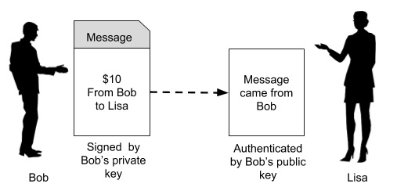
The transaction includes details such as the recipient's public key (address), the amount to be sent, and the sender's signature.
The signed transaction is broadcast to the blockchain network.
Nodes (computers in the network) verify the transaction. They use the sender’s public key to confirm that the signature matches the transaction data. This process ensures that the transaction has not been altered and is indeed authorized by the owner of the funds.

Slide 88
Example:
Alice wants to send 1 Bitcoin to Bob.
She creates a transaction specifying the amount and Bob's public key (address).
Alice signs the transaction with her private key, creating a digital signature.
Alice broadcasts the signed transaction to the Bitcoin network.
Nodes in the network use Alice's public key to verify the digital signature.
They check that Alice has sufficient funds and that the transaction has not been tampered with.
Once verified, the transaction is included in a new block
Bob receives the Bitcoin, and the transaction is recorded permanently on the blockchain.

Slide 89
